Slide 1
Use of routine care data in research
Marit Eika Jørgensen, Chief Physician
Bendix Carstensen, Senior Statistician

Slide 2
Agenda
Registers in Denmark
Register-based projects at Steno Diabetes Center

Slide 3
Reasons to do register-based studies
Long-term follow up
  Side effects of medication
  Mortality
  Natural history of disease
Selection bias
  Exclusion criteria in clinical trials
  Low participant rate in observational studies

Slide 4
Participation in observational studies
Study | Period | Participation rate (%)
Helbred78 | 1977 – 1978 | 84.4
Monica - I | 1982 – 1984 | 78.7
Monica II | 1986 – 1987 | 75.4
Monica - III | 1991 – 1992 | 69.3
Inter99 (baseline) | 1999 – 2000 | 52.5
Helbred2006 | 2006 – 2007 | 45.3
KRAM-study | 2008 – 2010 | 16.0

Slide 5
Types of registers
Clinical records
Clinical registers
Population level registers

Slide 6
Clinical records
(e.g. SDC electronic patient records)
Complete history of patients:
  HbA1c
  lipids
  blood pressure ...
Information on:
  dates of measurement
  date of diagnosis
  date of birth
Note: Intervals between visits depend on patients' status

Slide 7
Clinical registers
(e.g. Danish Adult Diabetes database)
Data collection (recording) at fixed intervals (once a year, e.g.)
Clinical data on individuals
Data collection independent of patients' clinical status w.r.t.
  HbA1c
  lipids
Missing data:
  a patient was not seen for an entire year
  a patient has moved
  a patient died (but was not recorded as such)

Slide 8
Population level registers
(e.g. Danish National Diabetes Register)
(cl)Aims to cover the entire population:
Limited information on each patient:
  date of birth
  date of diagnosis
  date of death
  sex
Monitoring of:
  DM occurrence (incidence rates)
  prevalence of DM
  mortality of DM patients
Important because we have:
  long term follow-up
  no patient drop-out

Slide 9
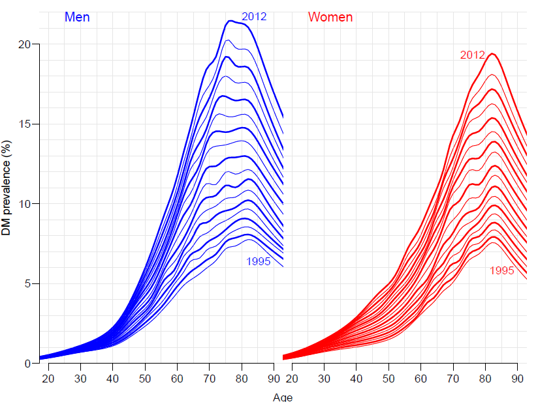
Diabetes in Denmark 1995-2012

Slide 10
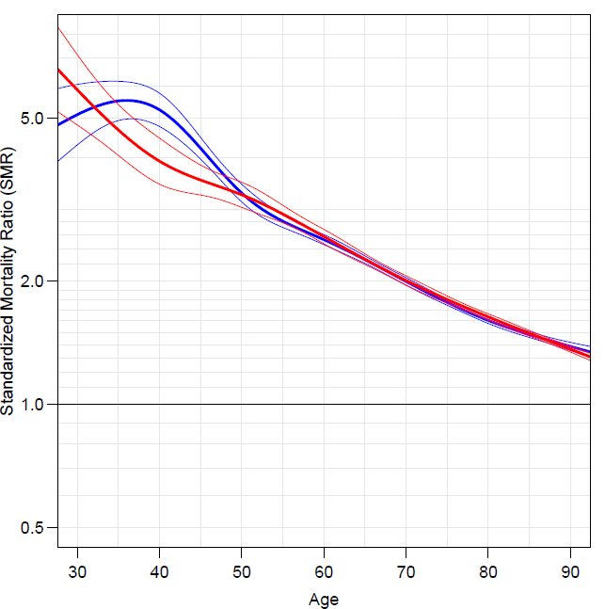
SMR (Standardised mortality ratio)

Slide 11
Use of clinical registers
Recall: Clinical registers collect clinical information on patients at regular intervals .
Used for monitoring of
How many % attain a HbA1c < 7% (53 mmol/mol)
How many % attended eye screening during the last year ?
How frequent are complications in different ethnicities?
...

Slide 12
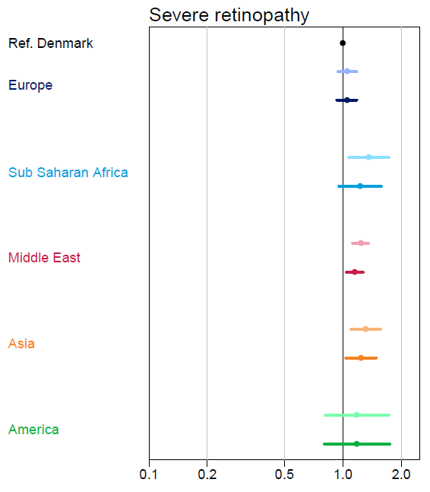
Complications in Danish DM patients by ethnicity:

Slide 13
Renal disease and CVD in SDC T1 patients
Patients with DN (diabetic nephropathy)
Occurrence of
  ESRD (end stage renal disease: dialysis or transplant)
  Death
How do rates depend on clinical parameters?
How is long-term outcome dependent on clinical status?

Slide 14
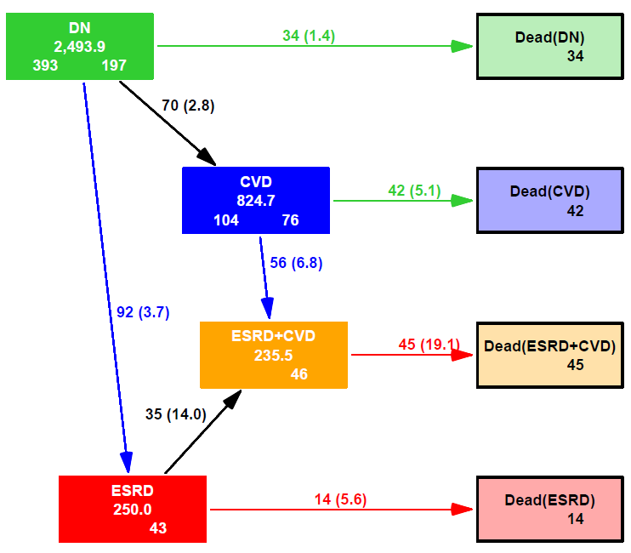

Slide 15
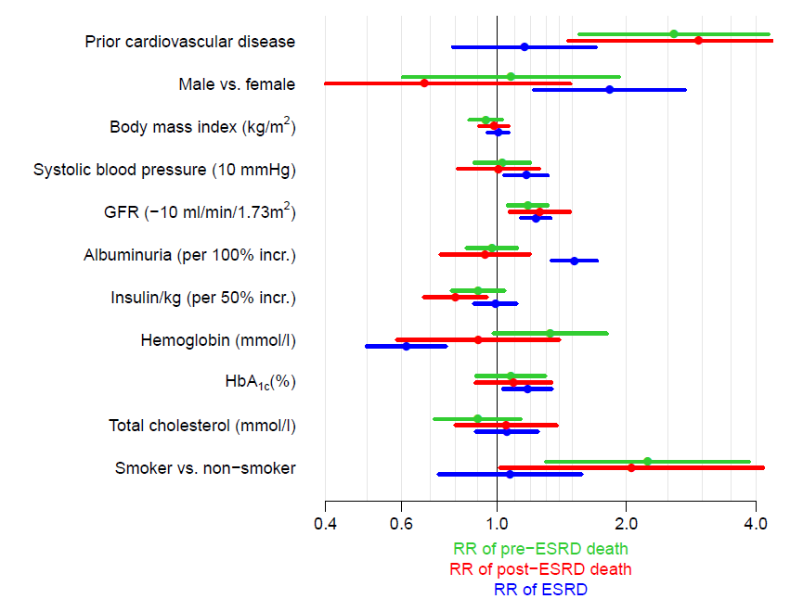

Slide 16
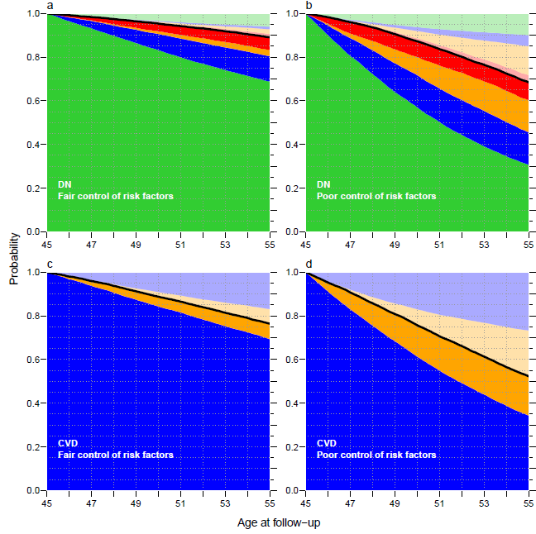

Slide 17
Requirement for analysis of clinical records
Well defined patient population (what is DN, CVD, ESRD)
Well defined research question:
  effect of clinical variables
  on rates
  on long-term outcome
Only possible through close collaboration between
  Clinical researchers: what is relevant, what is available, what is reliable
  Statistician: what is possible, what is relevant, what data is needed
The project took many hours of joint discussion to get the boxes right, and the hypotheses properly hammered out.

Slide 18
Register-based research in Denmark
Access to health care is free of charge
Since 1.4.1968, all persons with permanent residence in Denmark have been given a unique identification number (CPR-number)
All health events recorded in registers are identified by the CPR-number, and so are uniquely linkable
The CPR register contains among other things dates of birth, emigration, immigration and death

Slide 19
Medication Adherence at Steno Diabetes Center
Linkage of information:
  Electronic patient record of prescribed medication
  Records of filled prescriptions at Danish pharmacies (The Register of Medicinal Product Statistics)

Slide 20
Method
1st Rx
filled
prescription
1st written
prescription
¤
2nd Rx
3rd Rx
n^{th} Rx
¤
¤
¤
¤
¤
time
Waiting time
Holiday
Holiday
Holiday
>180 days
Initiation
Holiday
Gap
Persistent: patient is taking medication
Degree of Compliance: Proportion of Days
Covered with sufficient supply (PDC)
Time to Acceptance
Persistence
ceases because
days without
supply > 180 days
= Discontinuation
Acceptance
Days with sufficient supply
Days without supply

Slide 21
% of
patients
Metformin
% of
patients
Simvastatin
Years since index date
Years since index date
●In Compliance ●On ”Holiday”, out of compliance, but persistent ●Non-Persistent ●Non-Accepting ●Waiting

Slide 22
Morbidity and mortality among patients at Steno
Linkage of information:
  Electronic patient record
  Cause of Death Register
  Danish Patient Register

Slide 23
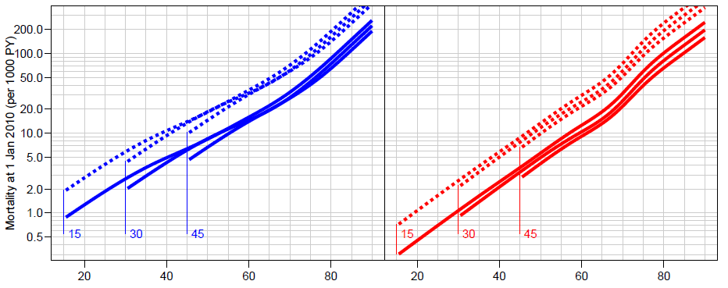
Mortality in type 1 by nephropathy status
Men
Women
Age / years
Age / years

Slide 24
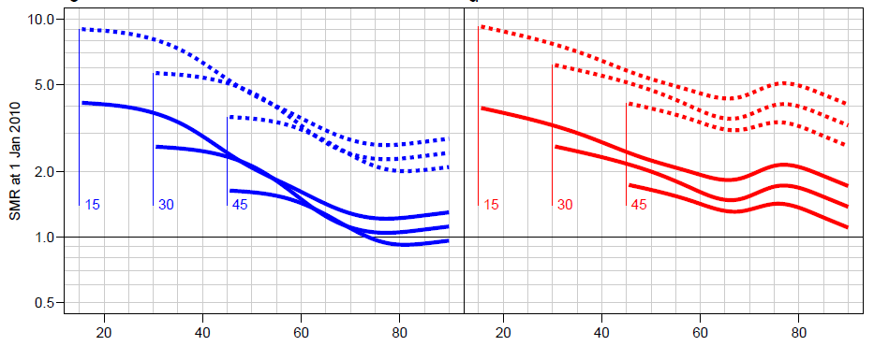
Standardised mortality ratio in T1D 2010
Men
Women
Age / years
Age / years

Slide 25
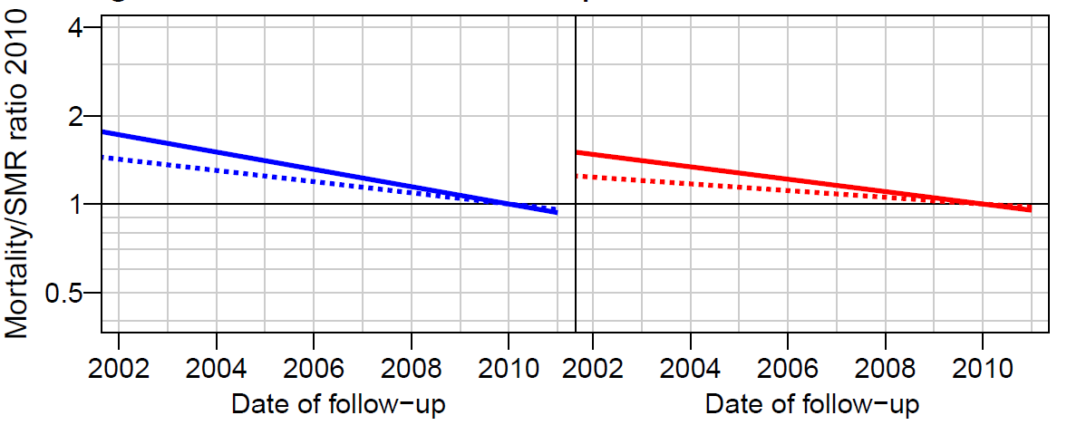
Time trends in mortality and SMR

Slide 26
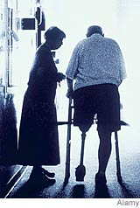
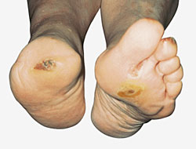
Amputations

Slide 27
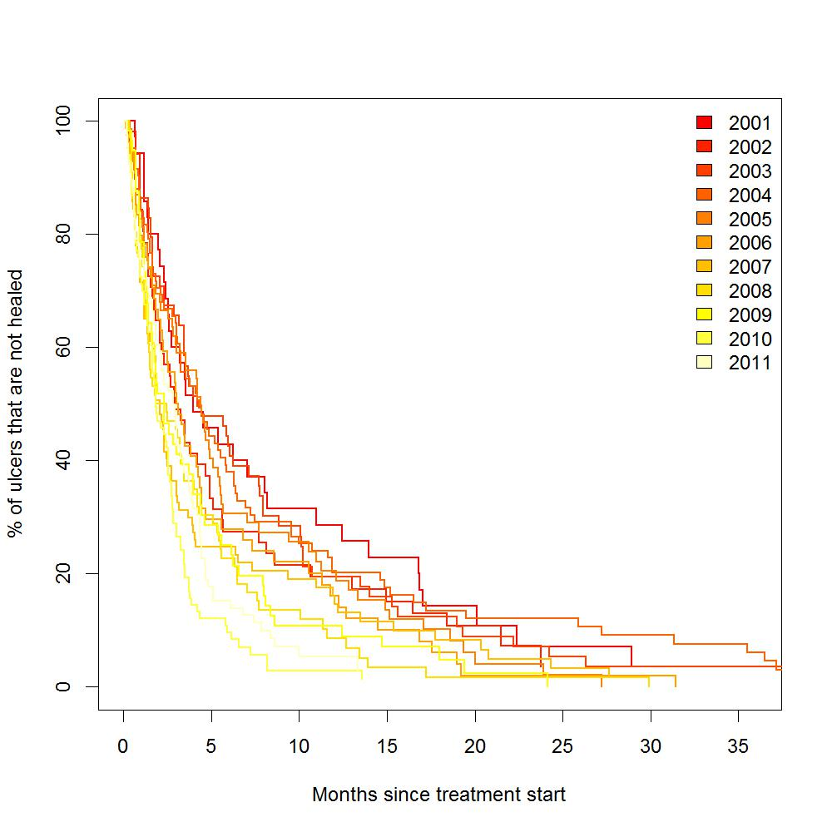
Incidence (left) and time to healing (right) of foot ulcers
N / 100 PY

Slide 28
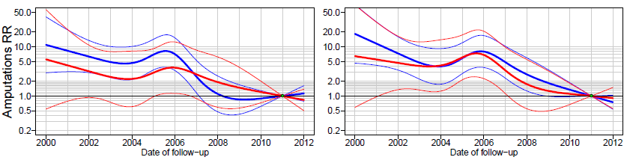
Time trends in major amputations
Type 1 diabetes
Type 2 diabetes

Slide 29
Use of clinical records: DATA
Well defined patient population:
  Start of attendance
  End of attendance - who is no longer affiliated with the clinic - otherwise we run the risk of counting persons who dies without our knowledge
Well defined (time-consistent) variable definitions
  Measurement methods are the same over time?
  Is the indication for measurement the same over time; this influences the actually obtained measurement values

Slide 30
Use of clinical records: ANALYSIS
Outcome definition (response, dependent variable):
  Death . HbA1c
  Healing of foot ulcer
Explanatory variables (predictors, independent variables)
  sex, age
  calendar time
  clinical measurements
  treatment

Slide 31
Use of clinical records: ANALYSIS
Note: Using treatment as explanatory variable induces (almost invariably) confounding by indication:
Patients are treated for a reason:
  the more treatment the worse the outcome, because
  treatment is a proxy for clinical status (beyond measurable variables)

Slide 32
Use of clinical records: STATISTICS
Continuous outcomes:
  HbA1c
  lipids
  GFR
  ...
  require repeated measures models (aka. mixed models, random effects models)
Event type outcome:
  death
  ESRD
  retinopathy
  require survival-type analysis:
    death - survival analysis
    all other: competing risks or multistate models

Slide 33
Clinical records, use of databases
Describe data:
  WHO
  WHAT
  WHEN
  (WHY)
Describe hypothesis or research question
  WHAT
  depend on WHAT
  and in particular HOW MUCH
Always specify research question in QUANTITATIVE terms, never "is there an effect of...".
There is one, but maybe so small that we do not bother.

