Slide 1
A flexible statistical approach for identifying and classifying heterogeneity Dorte Vistisen Steno Diabetes Center, Gentofte, Denmark
Latent class trajectory analysis

Slide 2
Agenda
What is it and why is it useful?
Sub-grouping people
In a cross sectional setting
For repeated measurements
Examples from the literature
Hands on
Software packages to fit data
Literature
Courses

Slide 3
Sub-grouping people
Men
Women
Vigorous
Moderate
Inactive

Slide 4
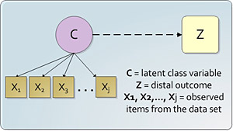
Latent class analysis In a cross sectional setting

Slide 5
Latent class analysis In a cross sectional setting
Latent classes
Glucose
Metabolic
profile
PAEE
(≥ 32.5 kJ/kg/day)
Active transportation
(≥ 0.25 hrs/day)
Sitting time at home
(≥ 4 hrs/day)
Sitting time at work
(≥ 3 hrs/day)
MVPA
(≥ 2½ hrs/week)

Slide 6
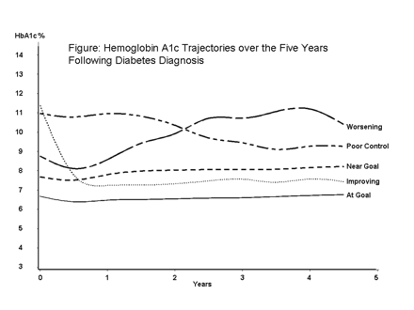
Latent class trajectory analysis For repeated measurements
Latent class trajectory analysis (LCTA) finds sub-groups in data with distinct patterns over time for one given characteristic

Slide 7
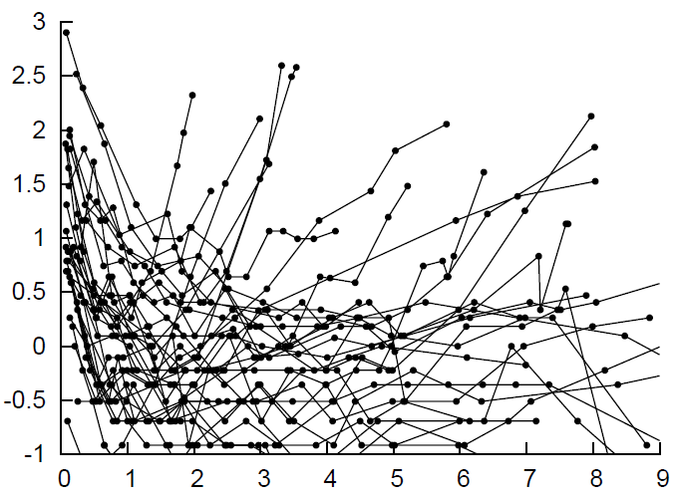
One pattern?
Prostate-specific antigen level
Time since radiation therapy

Slide 8
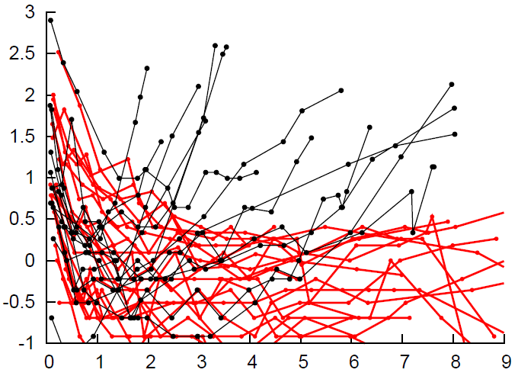
Or two patterns?
Prostate-specific antigen level
Time since radiation therapy

Slide 9
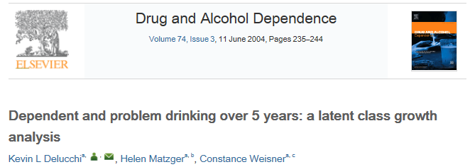
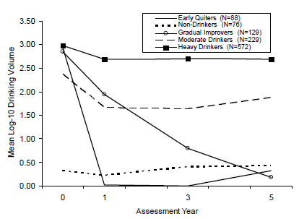
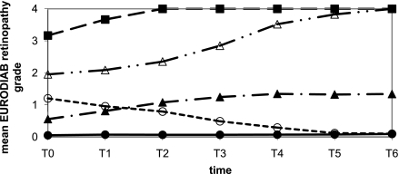
Examples from the literature

Slide 10
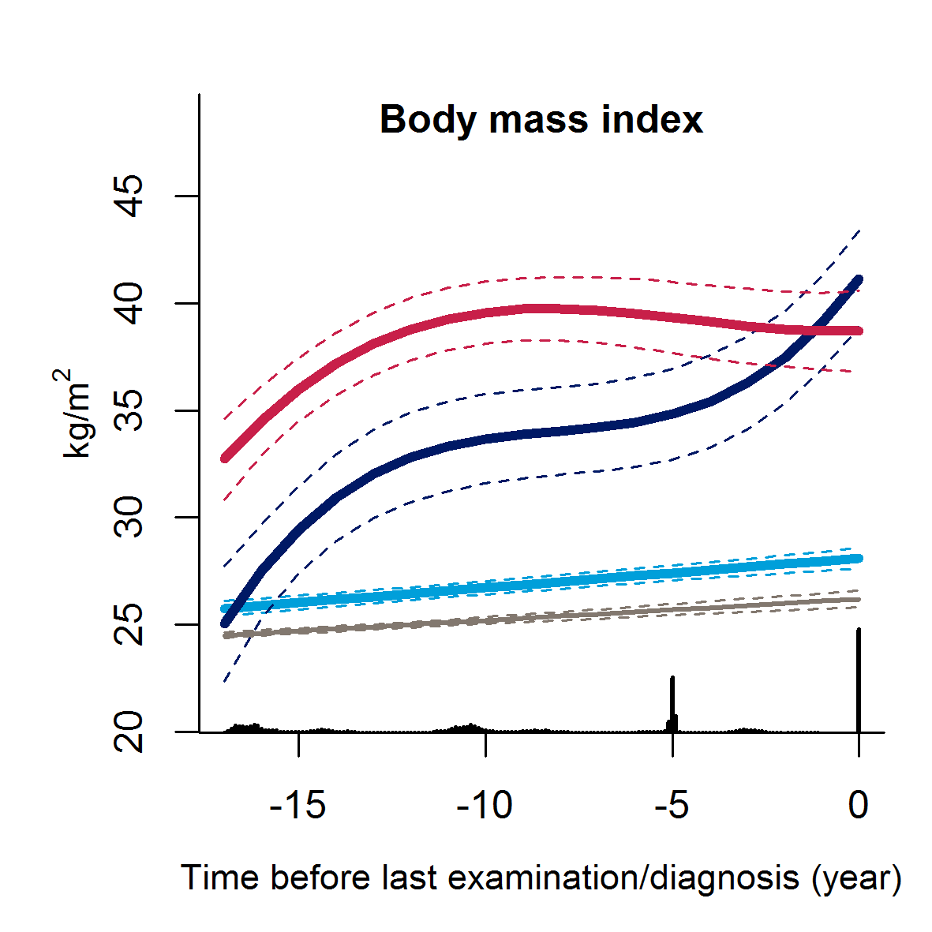
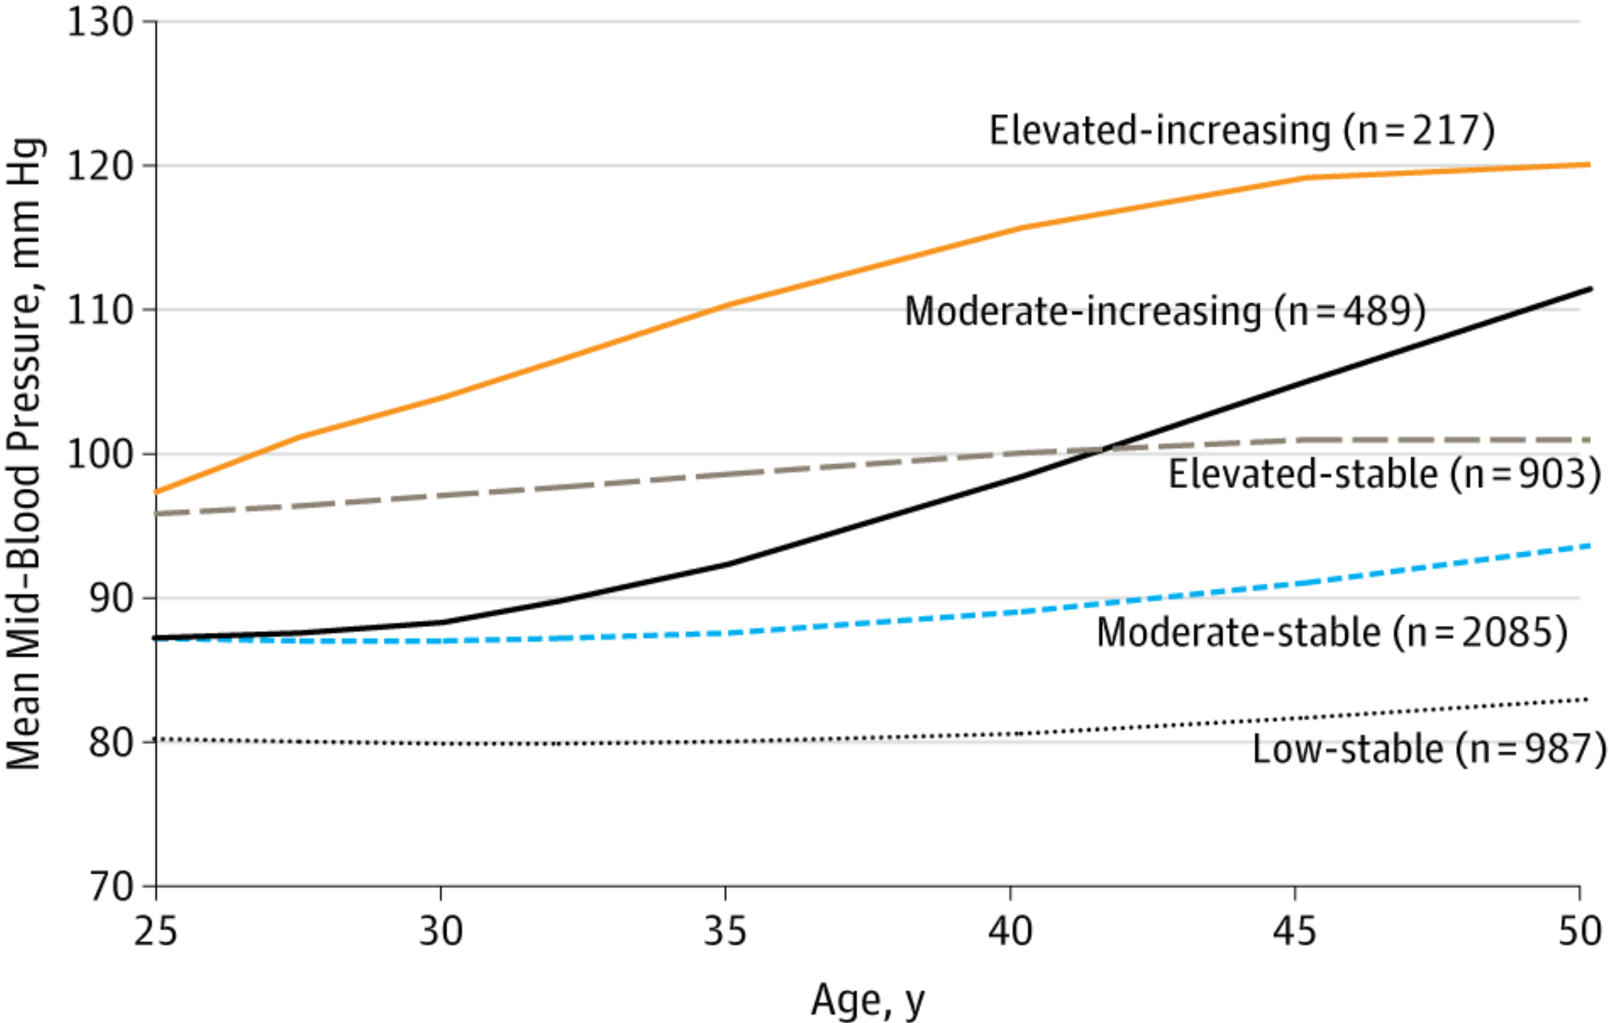
Examples from the literature
‘Persistently obese’
‘Progressive weight gainers’
‘Stable overweight’

Slide 11
Advantages and limitations
Advantages:
May uncover hidden heterogeneity in
Disease development before diabetes diagnosis
Complication development after diagnosis
Response to medication
Limitations:
Often finds very small groups
Data dependent – may be difficult to replicate patterns in other populations
Identified latent classes may depend on choice of model – linear vs cubic splines

Slide 12
Agenda
What is it and why is it useful?
Sub-grouping people
In a cross sectional setting
For repeated measurements
Examples from the literature
Hands on
Software packages to fit data
Literature
Courses

Slide 13
Software packages to fit data
Mplus (not freeware):
The pioneer in latent class trajectory analysis
http://statmodel.com
SAS (not freeware):
Proc Traj (individual variation is not allowed)
https://www.andrew.cmu.edu/user/bjones/
Stata (not freeware)
Gllamm command
http://www.stata.com/meeting/5uk/gllamm.html
R (freeware):
Lcmm package
http://cran.r-project.org/web/packages/lcmm/lcmm.pdf
SPSS:
Not available

Slide 14
Literature
Nagin DS and Odgers CL (2010). Group-Based Trajectory Modeling in Clinical Research. Annu. Rev. Clin. Psychol. 6:109–38
Andruff H, Carraro N, Thompson A, Gaudreau P (2009). Latent Class Growth Modelling: A Tutorial. Tutorials in Quantitative Methods for Psychology. 5: 11-24
Jung, T and Wickrama, KAS (2008). An introduction to latent class growth analysis and growth mixture modeling. Social and Personality Psychology Compass. 2: 302-317

Slide 15
Courses
Advanced SEM I: Measurement Invariance, Latent Growth Modeling & Nonrecursive Modeling (June 2-4, 2014), Wayne State University, Detroit, Michigan, USA: http://carma.wayne.edu/ShortCourses2014wsu.asp#advsem1
Latent Trajectory/Growth Curve Analysis (June 9-11 2014), The Howard W. Odum Institute for Research in Social Science, University of North Carolina, USA: http://www.irss.unc.edu/odum/contentSubpage.jsp?nodeid=21#9
Latent Growth Curve Modeling (June 9-13, 2014), Colombia University, NY, USA: https://www.cuepisummer.org/course/latent-growth-curve-modeling

