Slide 1
The Leadership in Epidemiological Analysis of longitudinal Diabetes-related data (LEAD) Consortium EDEG Satellite Symposium, Cagliari, Italy, 29 March 2014

Slide 2
Programme
9:30 – 9:50 Presentation of the LEAD consortium
Kristine Færch, Steno Diabetes Center, Gentofte, DK
9:50 – 10:40 Repetitive measurements over time: Opportunities and challenges
Bendix Carstensen, Steno Diabetes Center, Gentofte, DK
10:40 – 11:00 Coffee break
11:00 – 11:20 Latent class trajectory analysis
Dorte Vistisen, Steno Diabetes Center, Gentofte, DK
11:20 – 11:40 Cohort effects
Adam Hulmán, University of Szeged, Szeged, Hungary
11:40 – 12:00 Plenary discussion
12:00 – 13:00 Lunch

Slide 3
What is the LEAD consortium?
A consortium for European researchers working with longitudinal diabetes-related data
Initially started as a collaborative project among researchers working with data from the Whitehall II study
Sharing methods for data analysis
Common challenges related to longitudinal data analysis
Forum for exchanging knowledge and experience

Slide 4
Objectives of LEAD
To build a strong European network among leading researchers within the field of diabetes epidemiology
To develop and apply novel and innovative cutting-edge statistical methods
To set the standard for best practice diabetes epidemiology research in Europe
To educate younger researchers in diabetes epidemiology
LEAD
Build network
Develop methods
Best practice
Educate

Slide 5
LEAD Steering committee
Dept. of Clinical Epidemiology, Steno Diabetes Center:
Dorte Vistisen, MSC., PhD., Senior researcher, Chair
Kristine Færch, MSC., PhD., Senior researcher, Vice-chair
Christian Stevns Hansen, MD, PhD student, Financial administrator
Nanna Borup Johansen, MD, PhD, Postdoc, Secretary
Centre de Rechearche Public de la Santé, Strassen, Luxembourg
Daniel R. Witte, MD, PhD
First department of Medicine, Semmelweis University, Budapest , Hungary
Adam Tabák, MD
Institute for Clinical Diabetology, German Diabetes Center, Düsseldorf, Germany
Christian Herder, MSc, PhD

Slide 6
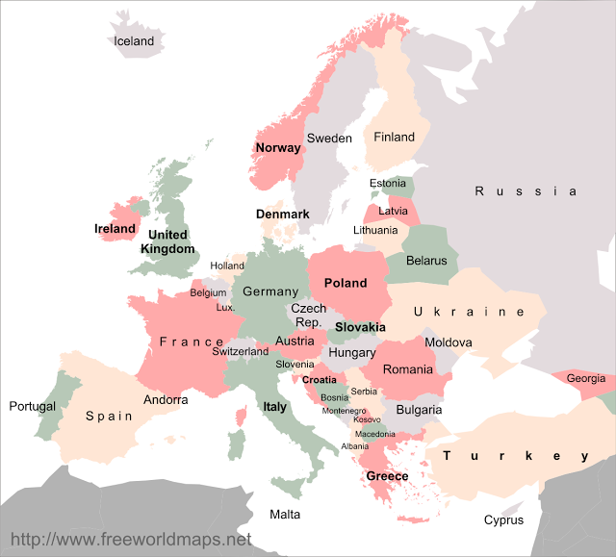
LEAD Members
UK:
Eric Brunner
Martin Shipley
Norway:
Kathrine F. Frøslie
Finland:
Mika Kivimäki
Luxembourg:
Daniel Rinse Witte
Denmark:
Dorte Vistisen
Kristine Færch
Christian Stevns Hansen
Nanna Borup Johansen
…
Germany:
Christian Herder
Hungary:
Adam Tabák
Adam Húlman
Cyprus:
Alex Heraclides

Slide 7
Planned activities 2013/14
Consortium meeting – steering committee only
UCL, London, UK on December 9th, 2013
EDEG Satellite Symposium – open for all members
Sardinia on March 29th, 2014
Consortium meeting – steering committee/members?
Steno Diabetes Center, Gentofte, DK in autumn 2014

Slide 8
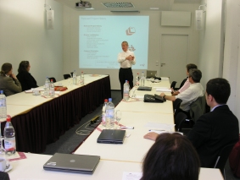
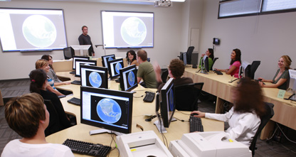
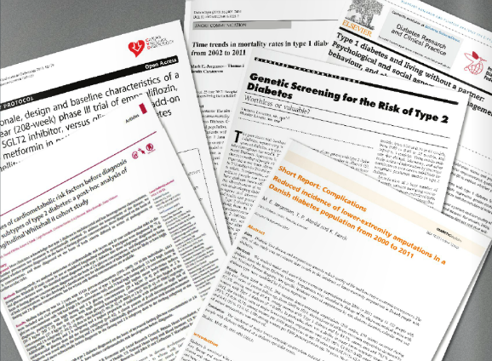
Other activities
Symposia/seminars
Hands-on workshops
Shared publications

Slide 9
Funding
2013 & 2014:
DKK 133,500 (~18,000 Euro)
DKK 35,000 (~4,700 Euro) Krista & Viggo Petersens Foundation
2015 & onwards:
???

